Slide 1
SCM 516- FINAL PROJECT
Team 321 Insight Knights
Ishika Gupta - 122931176
Vedant Sahu -1231053410
Aniket Srivastava -1230870578
Pin-Lin Lai - 1230644326

Slide 2

Classification
Obesity Dataset

Slide 3
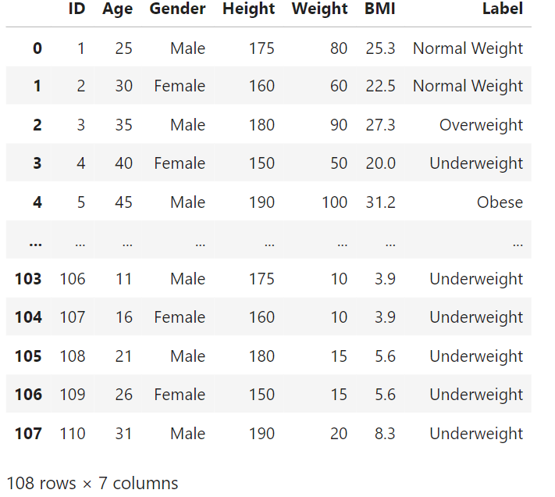
Dataset

Slide 4
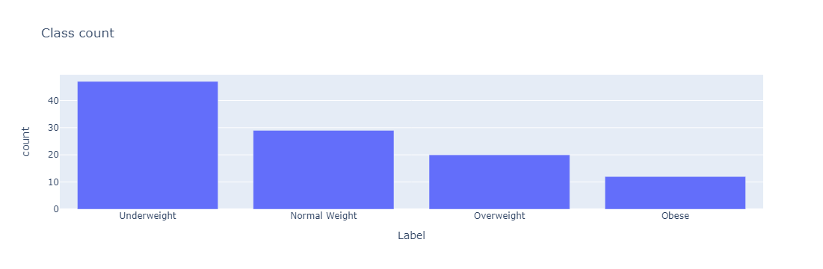
Data Exploration and Visualization
4 unique classes – multiclassification problem
Dataset is imbalanced

Slide 5
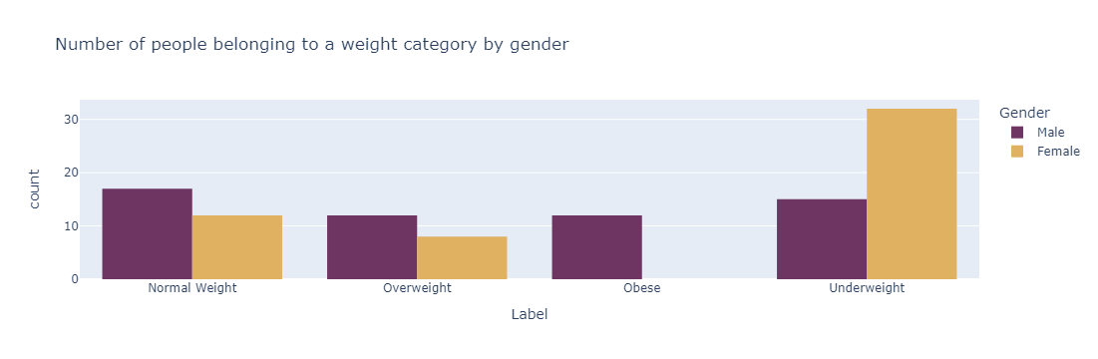
Data Exploration and Visualization

Slide 6
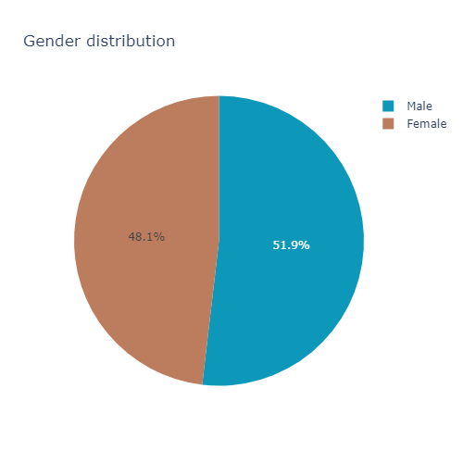
Data Exploration and Visualization

Slide 7
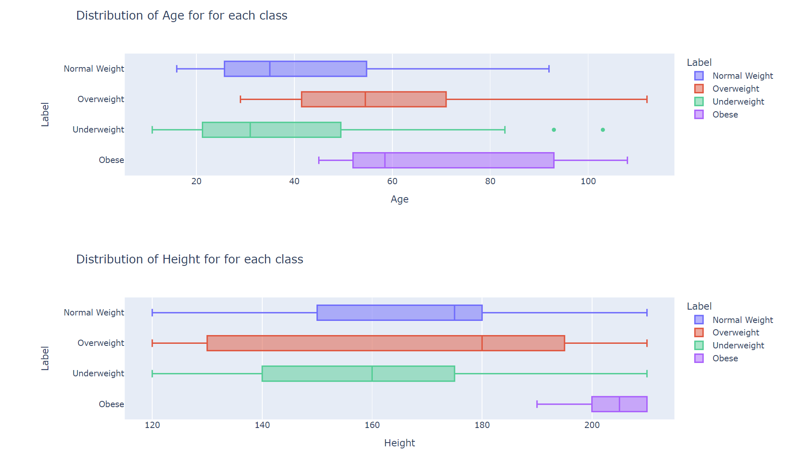
Data Exploration and Visualization

Slide 8
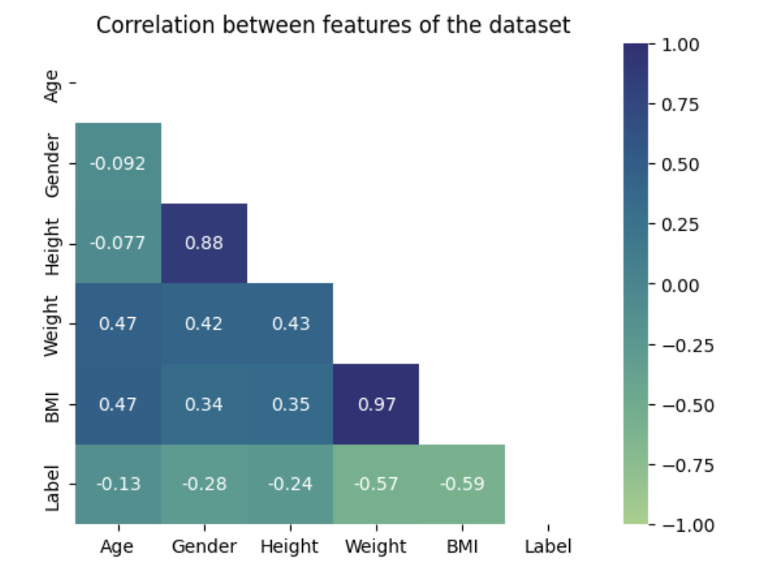
Data Exploration and Visualization

Slide 9
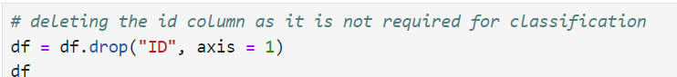
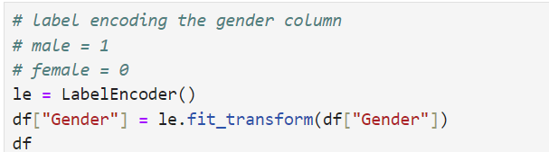
Data Preprocessing
Removing the ID column
Converting the ‘male’ and ‘female’ values to 1 and 0 using Label Encoder

Slide 10
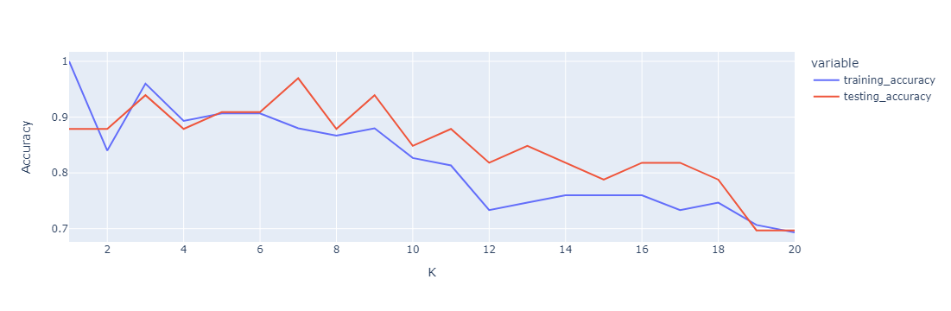
Building ML model – KNN without sampling
Best k value: 3

Slide 11
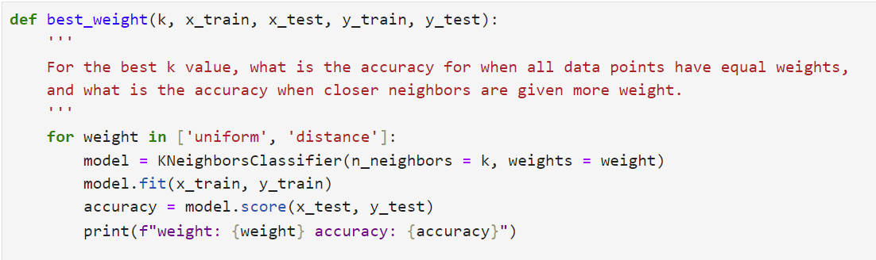
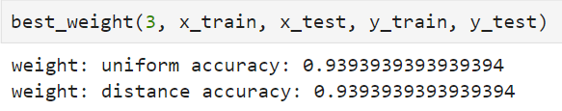
Building ML model – KNN without sampling
To use uniform or distance weights for higher accuracy?

Slide 12
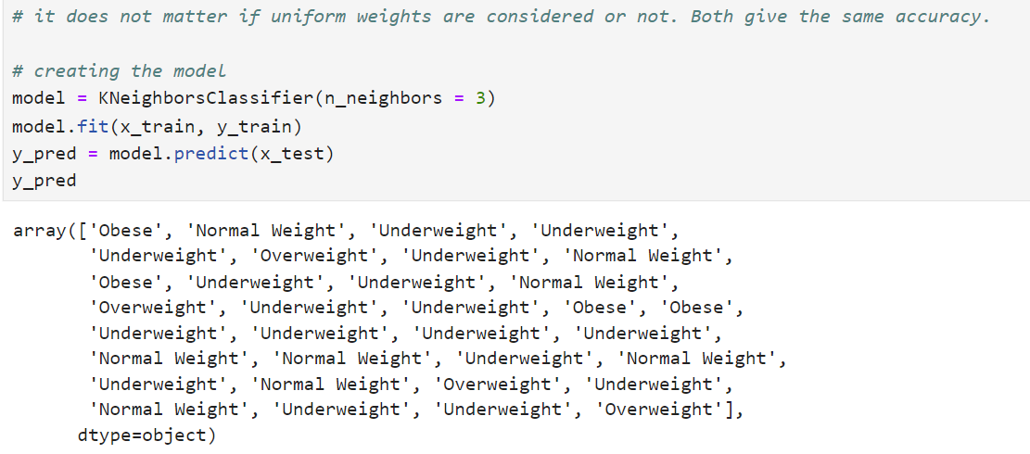
Building ML model – KNN without sampling
Final model:

Slide 13
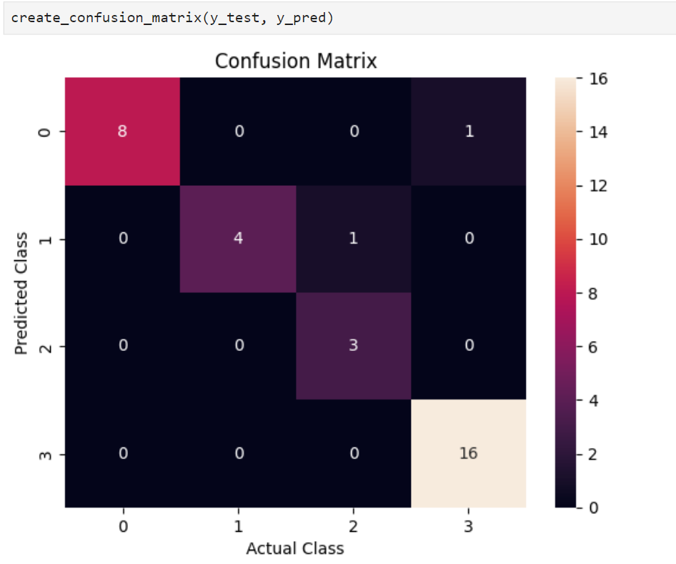
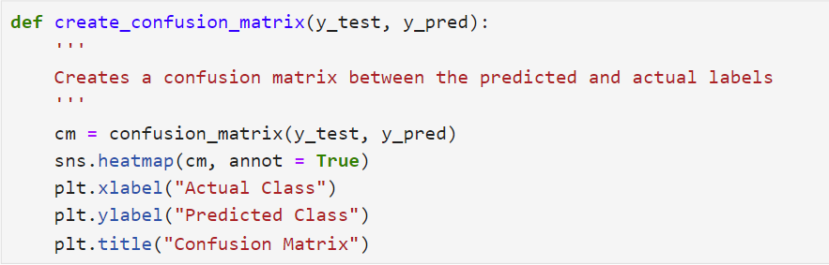
Building ML model – KNN without sampling

Slide 14
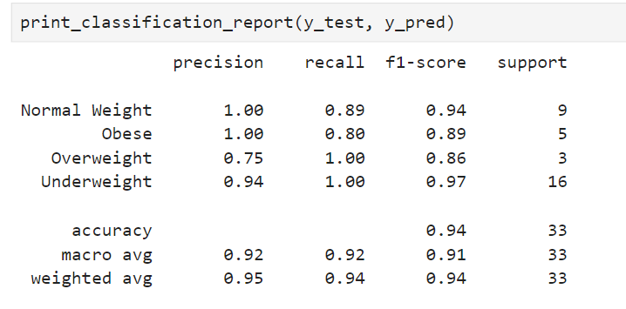
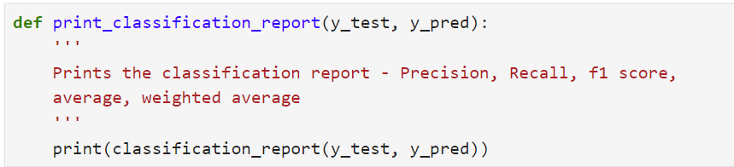
Building ML model – KNN without sampling

Slide 15
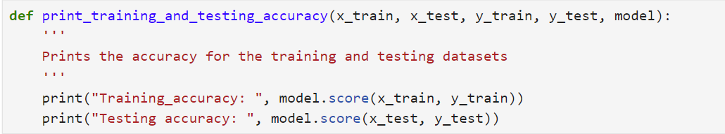
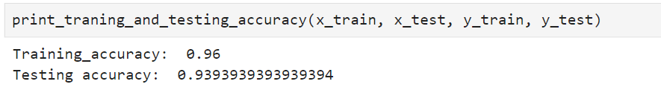
Building ML model – KNN without sampling

Slide 16
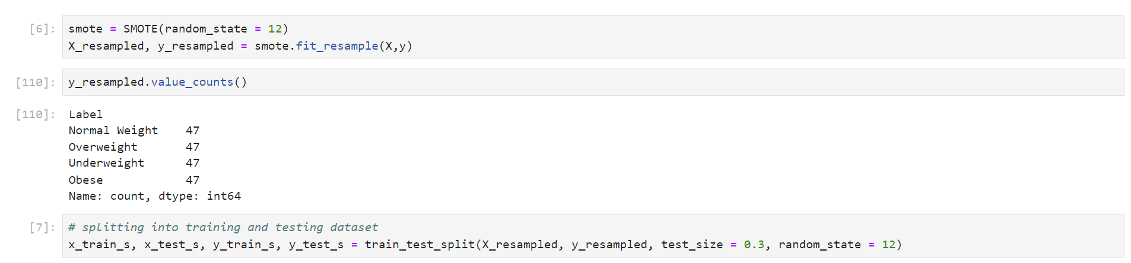
Sampling dataset
Using SMOTE Oversampling

Slide 17
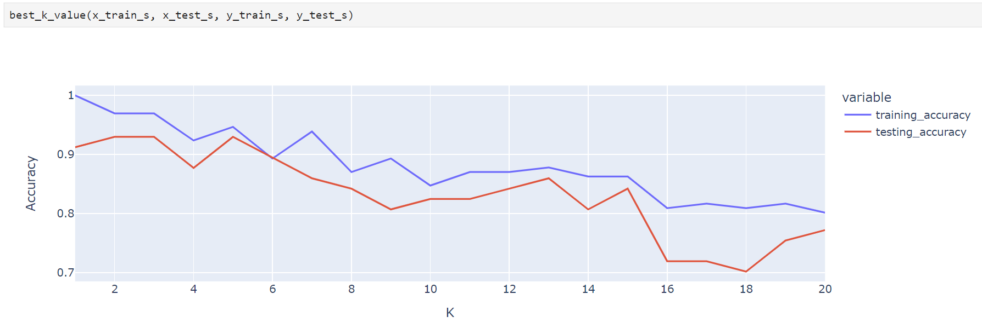
KNN – with sampling
Best k value: 3

Slide 18
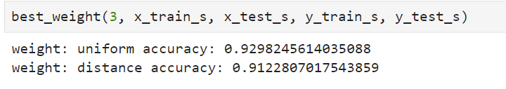
KNN – with sampling
Higher accuracy with uniform or distance weights?

Slide 19
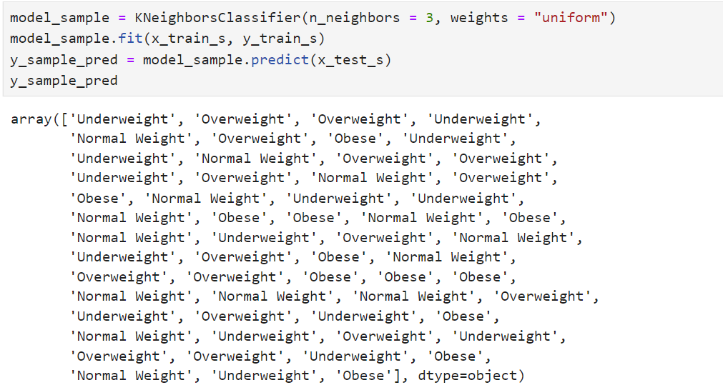
KNN – with sampling
Final KNN model:

Slide 20
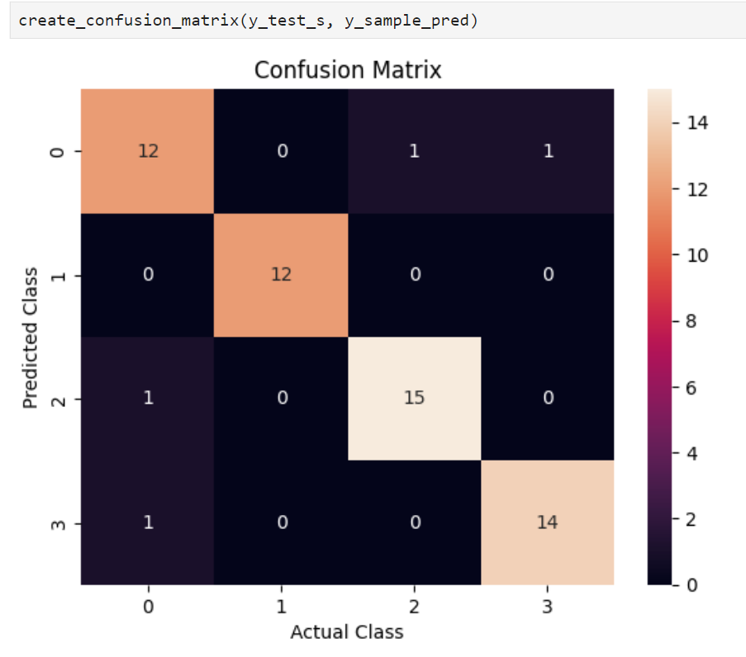
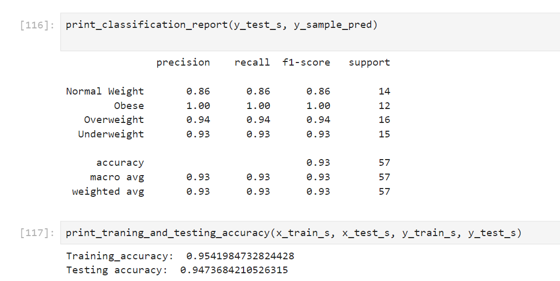
KNN – with sampling

Slide 21
Conclusion about KNN with and without sampling
Ideal value of k is 3 whether the data is sampled or not.
when data is not sampled, the same accuracy was achieved using uniform and distance weights - so it does not matter.
when data is sampled, higher accuracy was achieved using uniform weights when compared to distance weights.
when data is not sampled, the accuracy of training and testing is 96% and 94% approx.
when data is sampled the training and testing accuracies are both 95% approx.
Sampling the data reduced the training accuracy by 1% and increased the testing accuracy by 1%. So, sampling improved the overall performance.

Slide 22
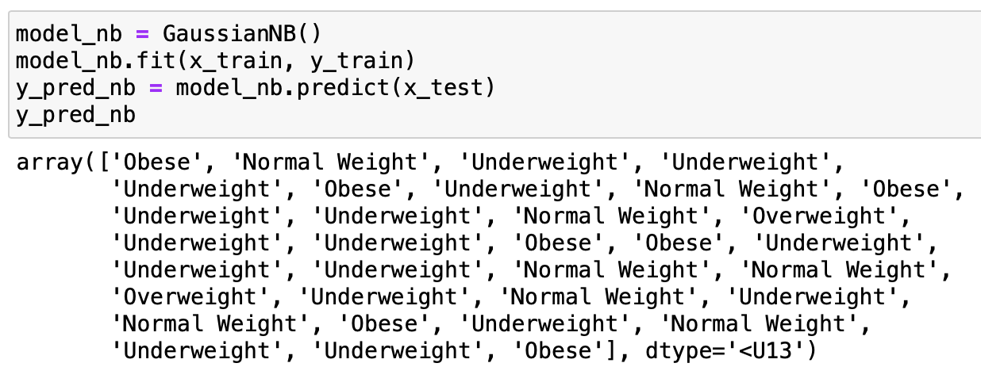
NAIVE BAYES – without sampling
Final model:

Slide 23
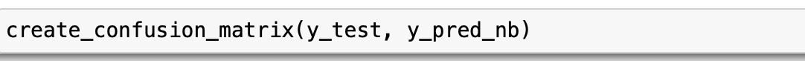
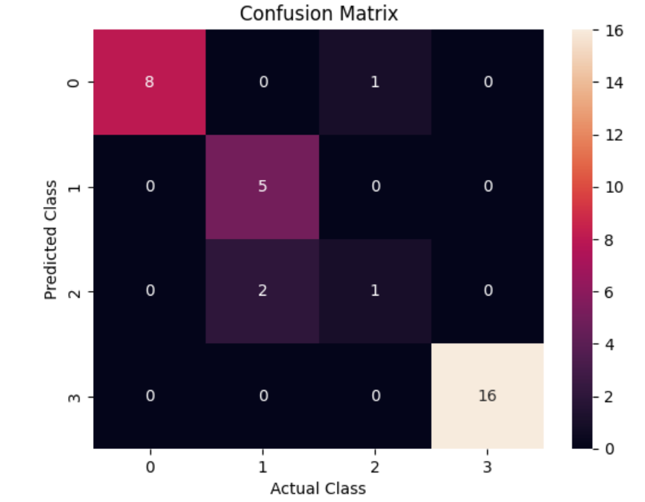
NAIVE BAYES – without sampling

Slide 24
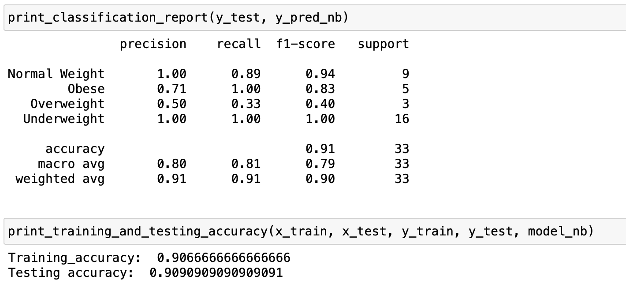
NAIVE BAYES – without sampling
KNN:

Slide 25
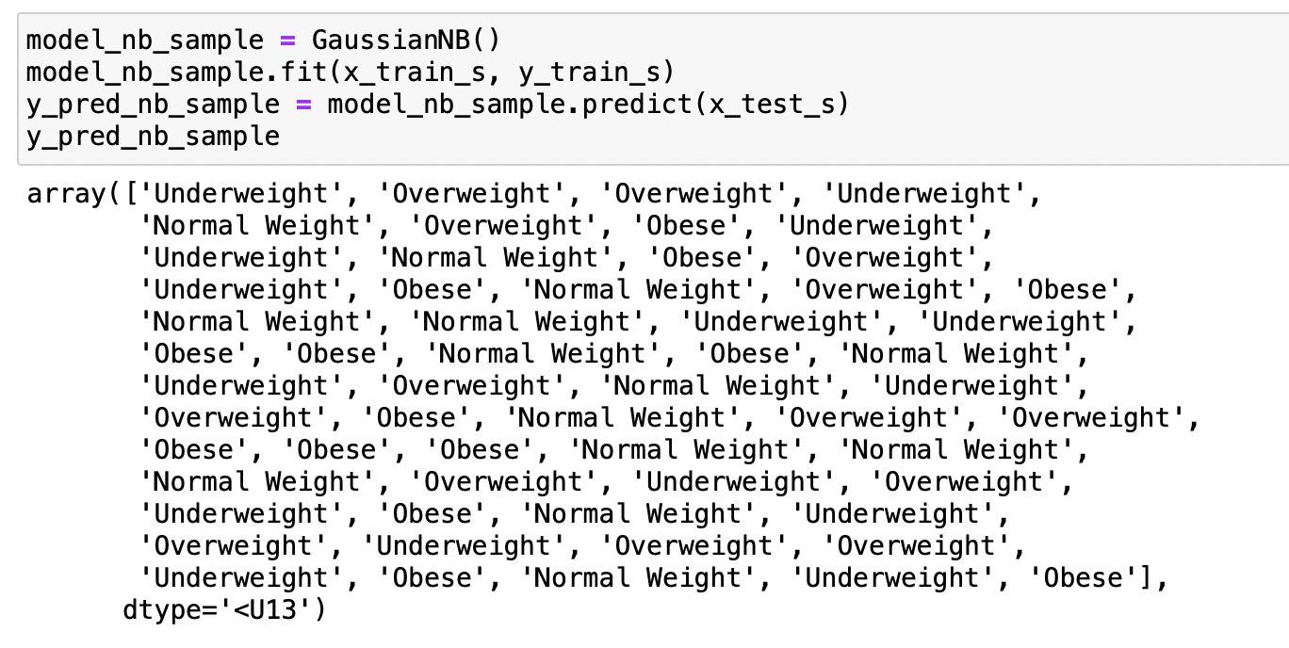
NAIVE BAYES – with sampling
Final model:

Slide 26
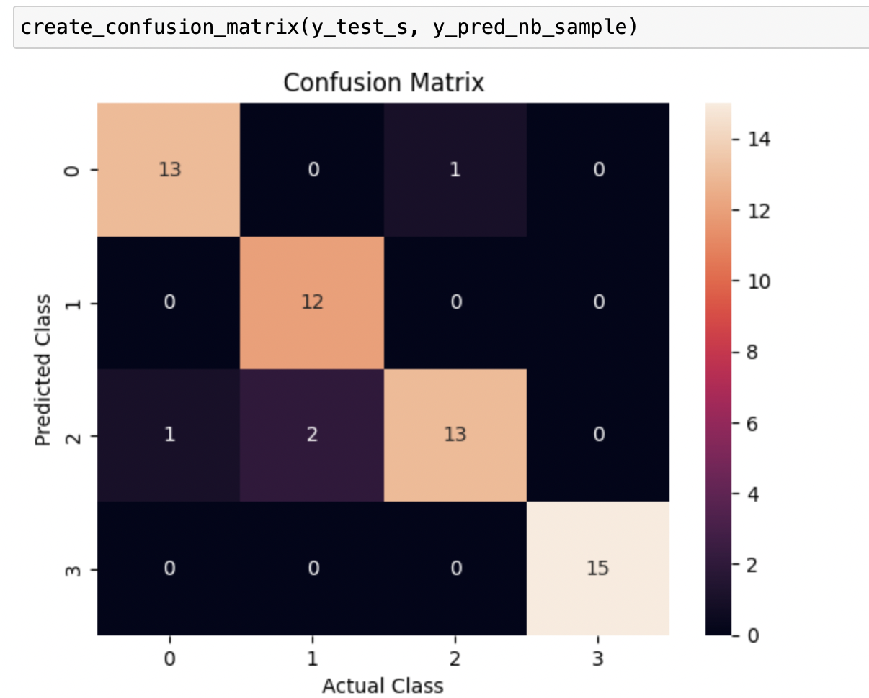
NAIVE BAYES with sampling

Slide 27
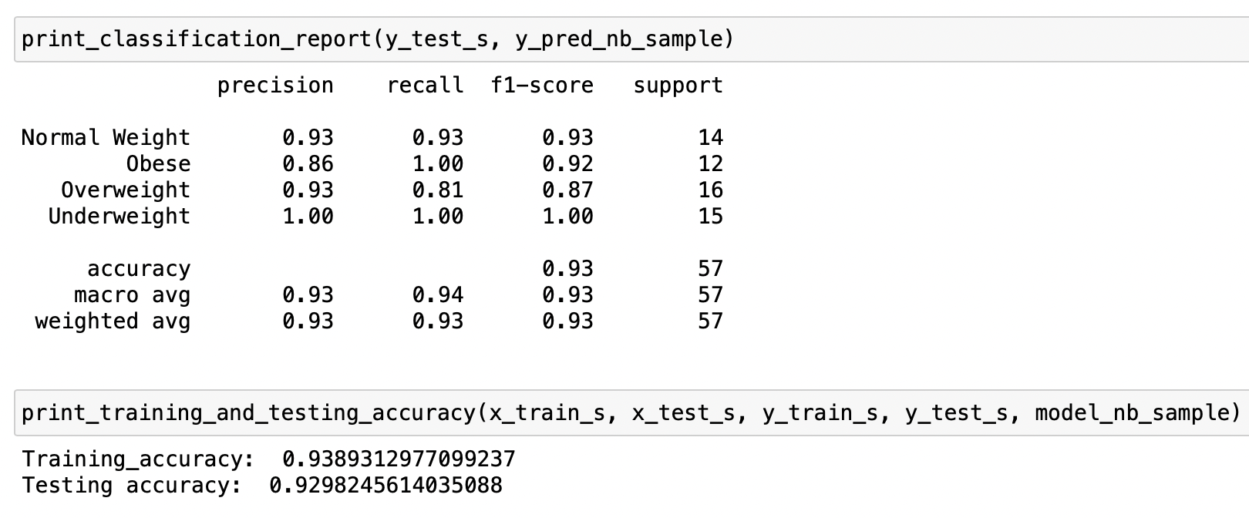
NAIVE BAYES with sampling
KNN:

Slide 28
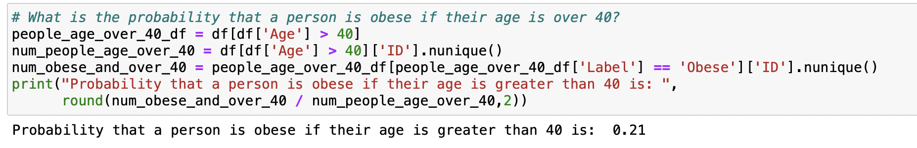
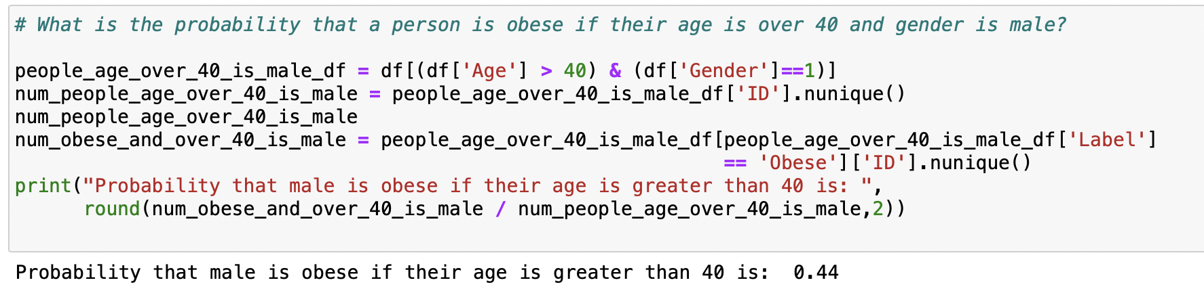
NAIVE BAYES conditional probability
P (Label = Obese | Age > 40)
P (Label = Obese | Age > 40, Gender = Male )

Slide 29
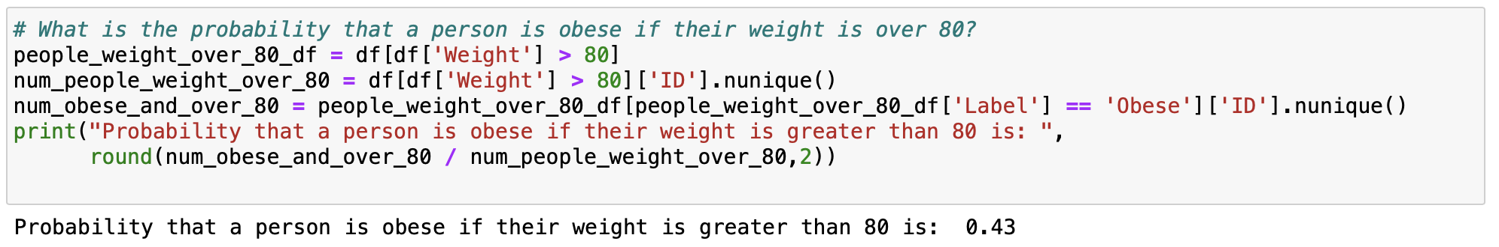
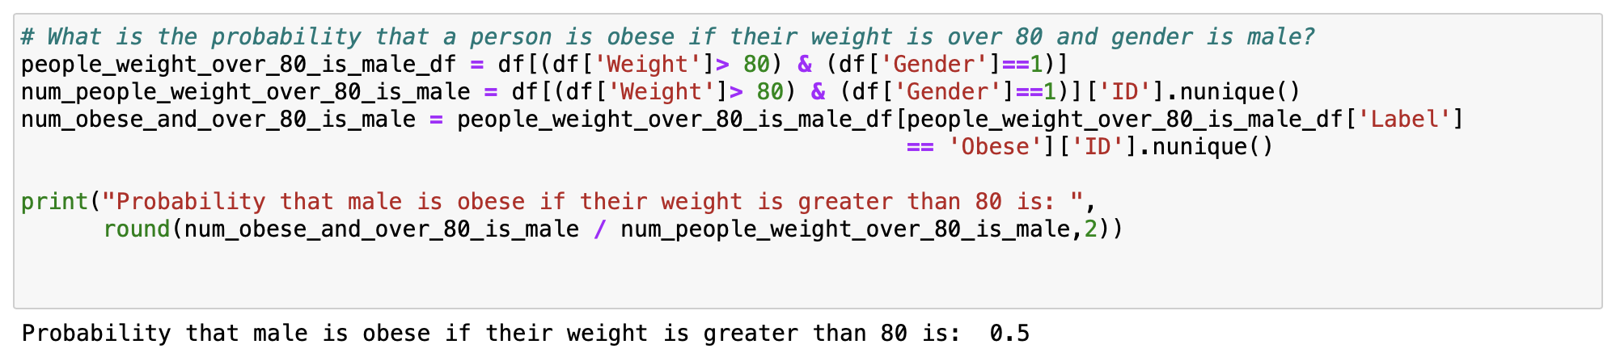
NAIVE BAYES conditional probability
P (Label = Obese | Weight > 80)
P (Label = Obese | Weight > 80, Gender = Male )

Slide 30
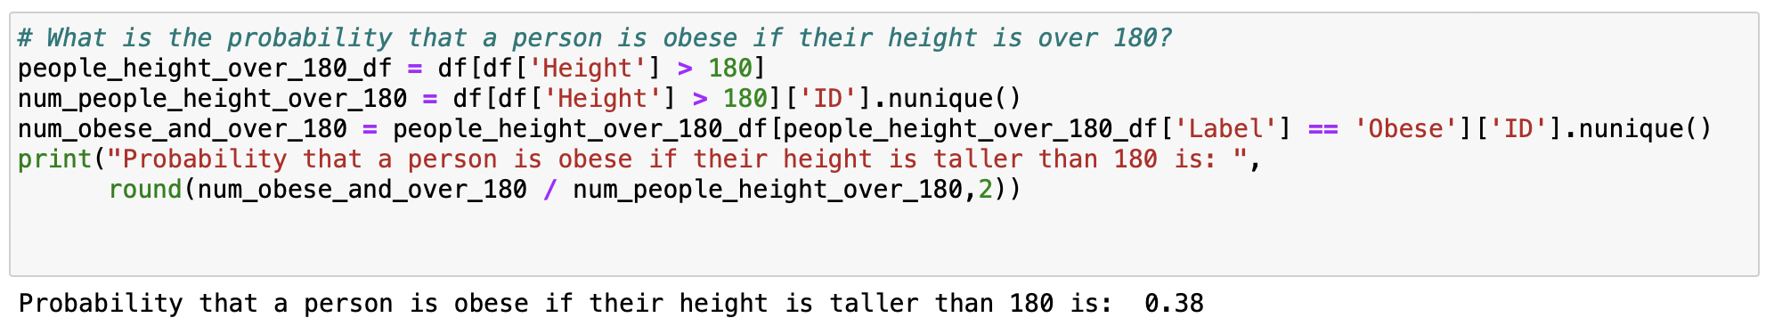
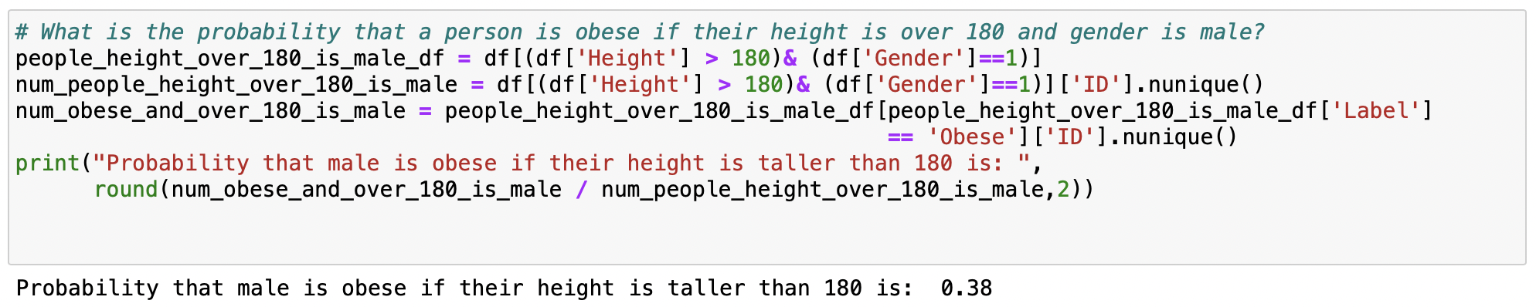
NAIVE BAYES conditional probability
P (Label = Obese | Height > 180)
P (Label = Obese | Height > 180, Gender = Male )

Slide 31
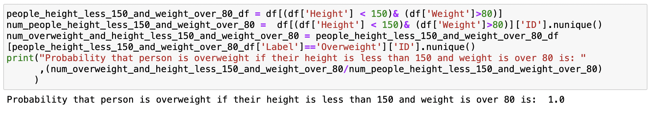
NAIVE BAYES conditional probability
P (Label = Overweight | Height < 150, Weight > 80 )

Slide 32
Conclusion about NAIVE BAYES with and without sampling
When data is not sampled, the training and testing accuracies are both 91% approx.
When data is sampled the accuracy of training and testing is 94% and 93% approx.
Sampling the data increased both training and testing accuracies by 3% and 2%. So, sampling improve all performance.

Slide 33
Conclusion about KNN and Naïve Bayes
Overall, no matter data is sampled or not, for training and testing accuracies, KNN is more accurate than NAIVE BAYES.
In each algorithm, sampling improved performance.

Slide 34
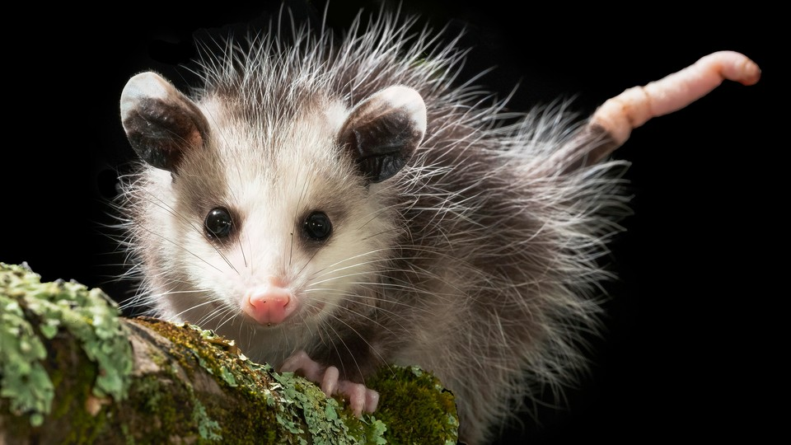
Regression
Possum Dataset

Slide 35
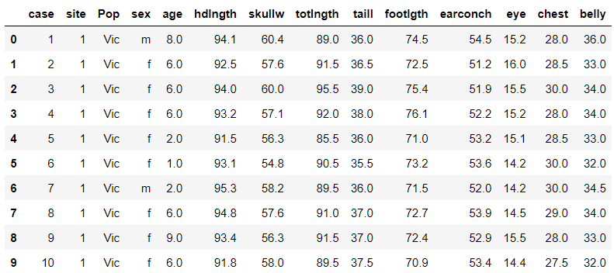
Introduction
Objective:
Develop multiple regression model to predict the value of response variable (dependent/target/output variable) based on a set of features (independent/input variables).
What should be included for regression analysis:
Make sure to include the equation of your regression model.
Make sure the interpretation of your regression model is included.
R2 and R2-adjusted value and their interpretations are included.
Calculate the correlation between input variables, as well as between inputs and output variables.
Show Mean absolute error (MAE), and other measured that are discussed for regression analysis.
Dataset Overview:
The possum data frame consists of nine morphometric measurements on each of 104 mountain brushtail possums, trapped at seven sites from Southern Victoria to central Queensland. Here using Regression method, we will try to determine:
Questions:
Can we use tot length to predict a possum's head length?
Which possum body dimensions are most correlated with head length and using the maximum correlated columns, predict possum's head length.

Slide 36
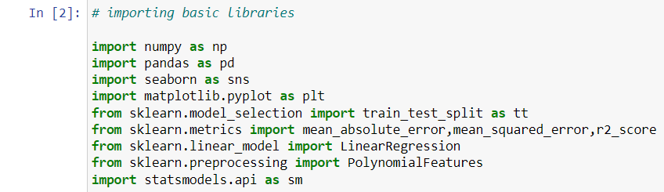
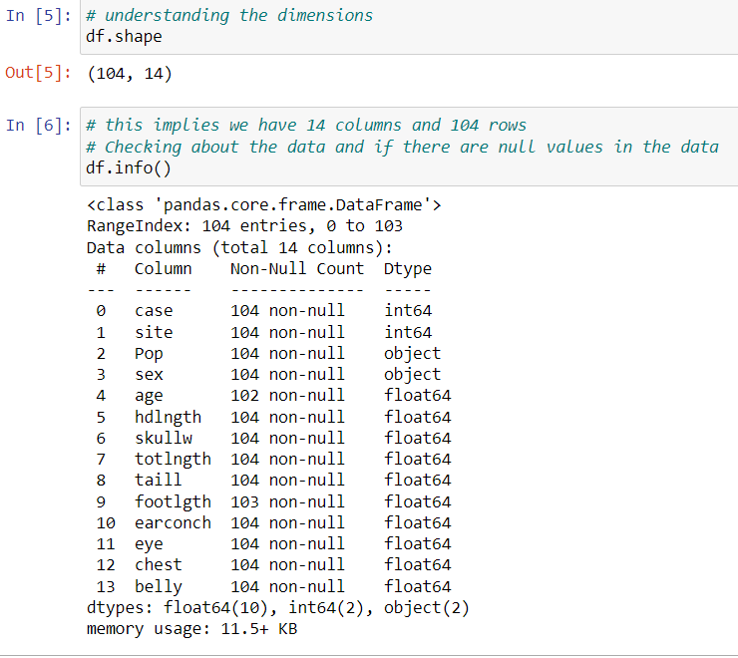
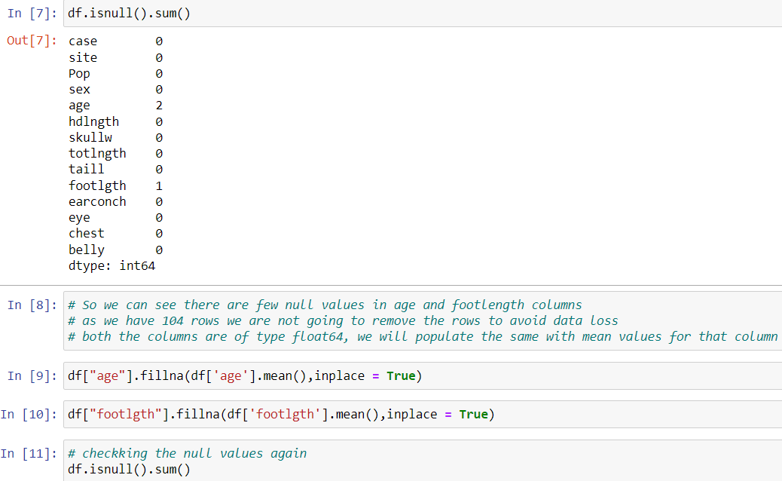
Data Preprocessing
Libraries Imported: Checking Data:
Handling Missing Values:

Slide 37
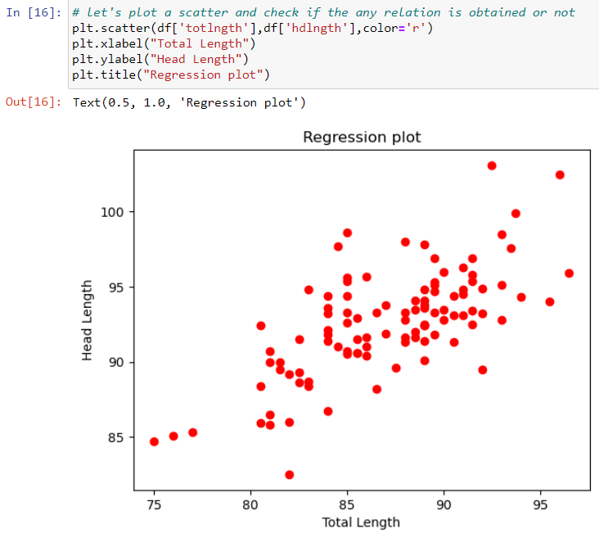
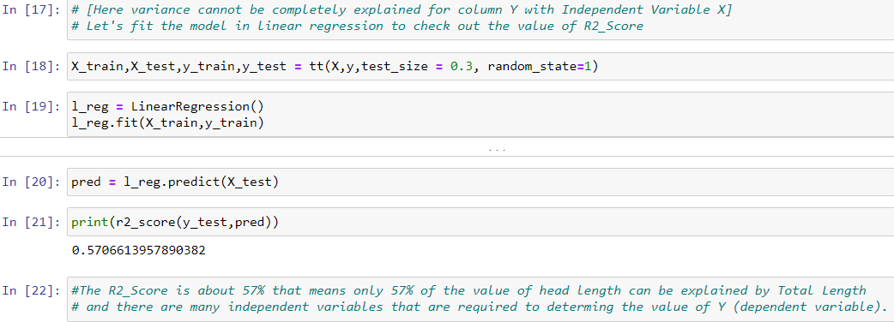
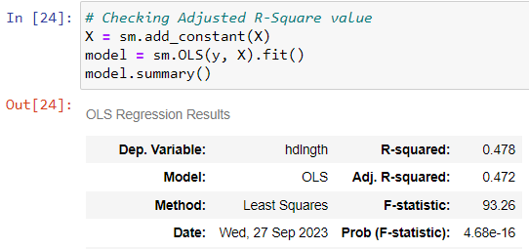
Exploratory Data Analysis (EDA)
Visualizing Relationships: R2_Score: 57%
OLS Model Results: Note:
# As observed that values are not completely explaining the variance for the dependent variable,
# let's try with more columns present in the file and perform Multiple Linear Regression
# Checking Co-relation between the columns so that we take appropriate columns for the model.

Slide 38
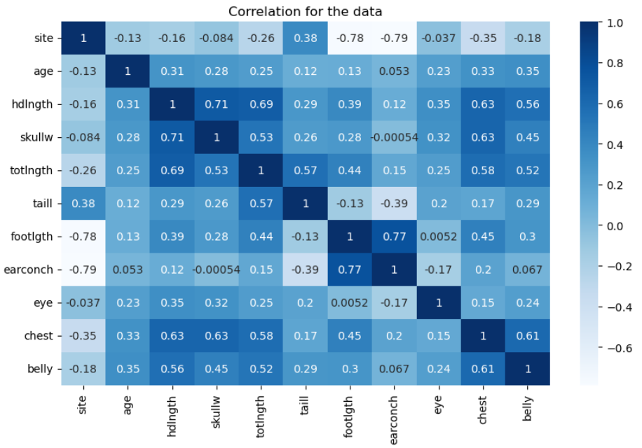
Correlation Analysis
Code:
correl = df.drop("case",axis=1).corr() plt.figure(figsize=(10,6)) sns.heatmap(correl,cmap = 'Blues',annot = True) plt.title('Correlation for the data’)
# As suggested above in the correlation plot, there are belly,chest,totlngth,skullw columns with correlation >0.5
X = df[['belly','chest','totlngth','skullw’]]
y = df[['hdlngth']]

Slide 39
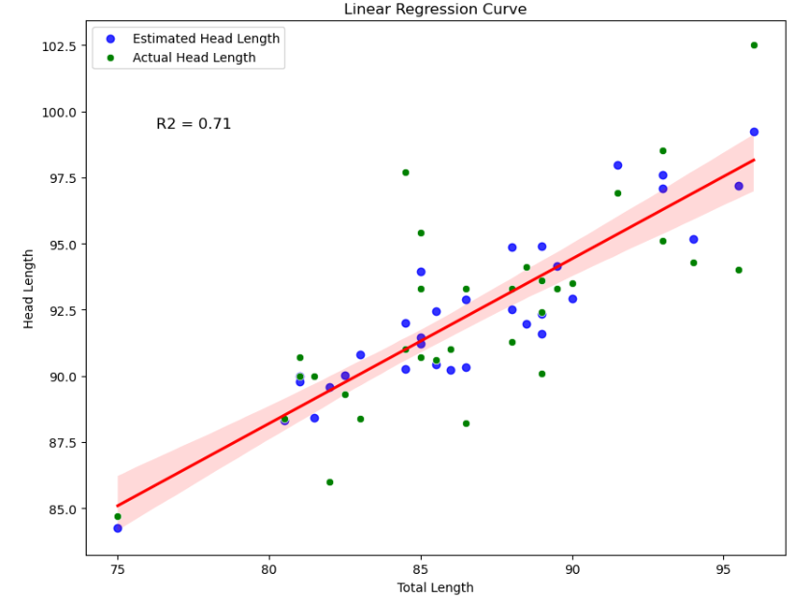
Model Development and Evaluation
[
Model Building
Multiple Linear Regression with Belly, Chest, Total Length, and Skull Width to find Head Length
# As suggested above in the correlation plot, there are belly,chest,totlngth,skullw columns with correlation >0.5 X = df[['belly','chest','totlngth','skullw’]] y = df[['hdlngth’]] # let's split this data and fit them in the model X_train,Xtest,y_train,y_test = tt(X,y,test_size = 0.3,random_state = 1) l_reg = LinearRegression() l_reg.fit(X_train,y_train) y_hat = l_reg.predict(Xtest)
mean_absolute_error(y_test,y_hat) mean_squared_error(y_test,y_hat) R2 = r2_score(y_test,y_hat) intercept = l_reg.intercept_ slope = l_reg.coef_
# as we have the required details, let's find out the regression plot here with the most strongly correlated X value columns plt.figure(figsize = (10,7.68)) sns.regplot(x=X_test['totlngth'].values, y=y_hat, scatter_kws={'color': 'blue'}, line_kws={'color': 'red'}, label='Estimated Head Length’) sns.scatterplot(x=X_test['totlngth'].values, y=y_test['hdlngth'].values, color='green', label='Actual Head Length’) # Add labels and title
plt.xlabel('Total Length’) plt.ylabel('Head Length’)
plt.title('Linear Regression Curve’)
# Adding R2_Score to the curve
plt.text(0.1, 0.8, f'R2 = {R2:.2f}', transform=plt.gca().transAxes, fontsize=12)
Model Evaluation
ean Absolute Error (MAE) | 1.509
Mean Squared Error (MSE) | 3.677
R2 = r2_score(y_test,y_hat) | 71%
Intercept | 29.865
Slope | [ 0.28095813, 0.0514124 , 0.31357863, 0.43809086]
Equation | Y-hat = 0.281X1 + 0.051X2 + 0.314X3 + 0.438X4 + 29.87

Slide 40
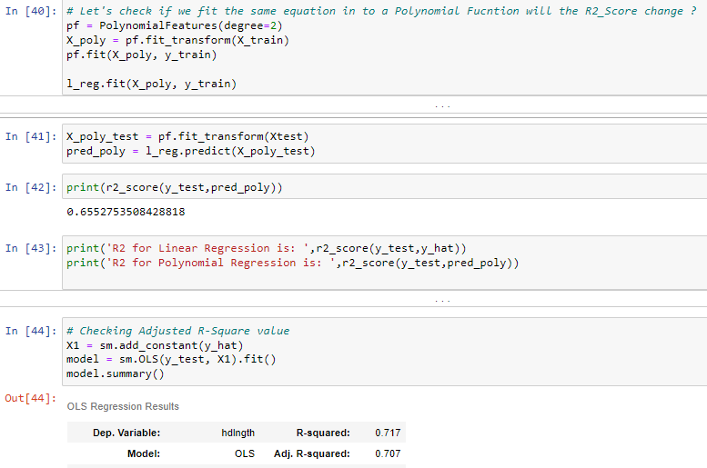
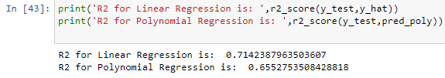
Comparison with Polynomial Regression
Introduction:
The objective of this comparison is to evaluate the performance of both Linear and Polynomial Regression models in predicting possum head length based on morphometric measurements. Polynomial Regression is an extension of Linear Regression that allows us to capture non-linear relationships between the independent and dependent variables by introducing higher-order terms
# Increasing the degree reduced the R2_Score,
so we will be sticking with multiple linear regress instead
of Polynomial regression

Slide 41


Cater to Assumption
Final Correlation
# Checking the correlation between Input and Output Variables
data1 = pd.DataFrame({})
data1 = X_test.iloc[:,:]
data1['hdlngth'] = y_test['hdlngth']
data1['y_hat'] = y_hat
data1
# We can see almost equal number of data points are distributed around residual = 0, therefore our assumption that data is
# normally distributed is true.

Slide 42


